Slide 1
C++ Course
Games Academy Berlin 2015-05-19 - Day 1
Benjamin Nitschke - Delta Engine

Slide 2
About me: BenjaminNitschke.com
2002-2004: First commercial .NET Game: Arena Wars
2005: Rocket Commander Tutorial, 1 Million Views
2006: Wrote Professional XNA Game Programming Book
2008: meinSport.de Online Sport Community Site
2009: FireBurst Xbox, PlayStation, PC with Unreal Engine
2010: Released Games on iOS, Android, WinPhone, W8 ..
2012: SoulCraft Mobile RPG (10+ Million Downloads)
since 2012: CEO Delta Engine, .NET to C++ Conversion
Notes:
2006: Created XNA Racing Game, one of the first full hd games on Xbox 360 and very popular XNA showcase game, got around 1 million youtube views
Current interests are compilers, functional languages and engines in general. I am also creating a new low level computer language that can write itself for future work. Most recently learned and used Clojure, Lisp and F#, worked on a few smaller games with our engine and some bigger contract work (native iOS, Android development), also helped SoulCraft development and just released it on Steam this week.

Slide 3
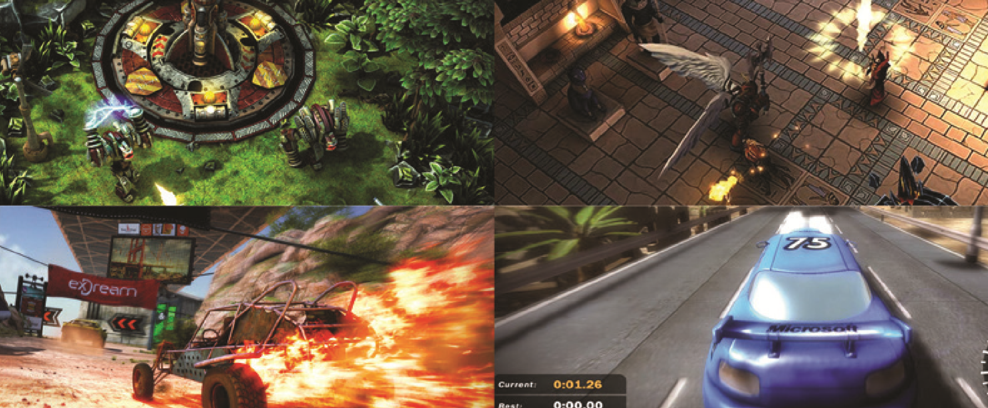
About me: Games created
Notes:
Arena Wars (2002-2004), SoulCraft (2012), Fireburst (2009) and XNA Racing Game (2006)

Slide 4
We will create one game every day :)
Day 1: Basic C++ Statements, Console IO
Text Adventure
Day 2: OpenGL Graphics Programming
Space Invaders
Day 3: Advanced 3D and C++ Topics
3D FPS (Walls, Camera, Movement)
Day 4: Unreal Engine C++ Primer, Q&A
Actors, Cameras, Particles, Spawning
Notes:
We will get a quick overview about C++, not all in-depth features can be fully explained in this short course. Our focus is also how game engines utilize C++ and learning C++ by actually writing code and doing useful stuff. There are plenty of books and links at the end of each presentation for more detailed study.

Slide 5
Why C++?
C++ is a high-level language with strong ties to low level performance and optimizations
Portability: C runs on pretty much any platform ever created, especially on mobile and consoles
Game Programming is mostly about C++ or Scripting, mobile development is either using an engine or doing low level performance C++
Notes:
C++ is derived from C, which is a systems programming language. While you write in a high level language, pretty much all types and basic operations are mapped to similarly assigned computer memory and instructions at the modern hardware level. This is what allows good low level performance, but only if you know what you are doing (data driven architecture is a big topic and also important for high performance games). For graphics or physics programming using assembly code mixed in C++ code is not uncommon to even achieve better performance at the very lowest levels.

Slide 6
Why not C++?
C++ can be an ugly mess compared to newer languages (Java, C#, Python, Lisp, F#, etc)
More coding is required (which is good for customization), C#, Lua, F# are more concise
Memory leaks (dangling pointers) are hard to avoid (takes years to become a pro)
Many Standards (C++11, C++14, Boost, Std..)
Notes:
http://www.itworld.com/article/2918583/open-source-tools/c-leads-the-way-in-ugly-hacks.html
http://techcrunch.com/2015/05/02/and-c-plus-plus-too/

Slide 7
When to use C++?
Large legacy projects (many game engines)
System applications & Drivers (low level)
Games & Graphics Programming
Data Structures & Fine Grained Flow Control
Performance (e.g. converting scripts to native code in an engine like Unreal)

Slide 8
When not to use C++?
If you are still a beginner (it will hurt)
Small programs & Scripting
Fast Prototyping or Fast Compilation
Using an engine or existing code or tools that does not support native C++ (easily)
e.g. Unity3D or XNA
Web (there are much better choices)
Repl, Reloading code (possible, but hard)

Slide 9
IDEs Galore
NetBeans, Visual Studio, Eclipse, Emacs, VI, gcc (command line), Code::Blocks, CLion, AppCode, C++Builder, CodeLite, Dev-C++, Geany, GNAT, KDevelop, LabWindows, MonoDevelop, OpenWatcom, Xcode, Qt Creator, Ultimate++ TheIDE, wxDev-C++, Rational Software Architect, Philasmicos, Oracle Solaris Studio, Pelles C, and many more ...
Notes:
CLion was just released a week ago by JetBrains, makers of IntelliJ, one of the most popular Java IDEs and ReSharper, the best C# Extension for Visual Studio

Slide 10
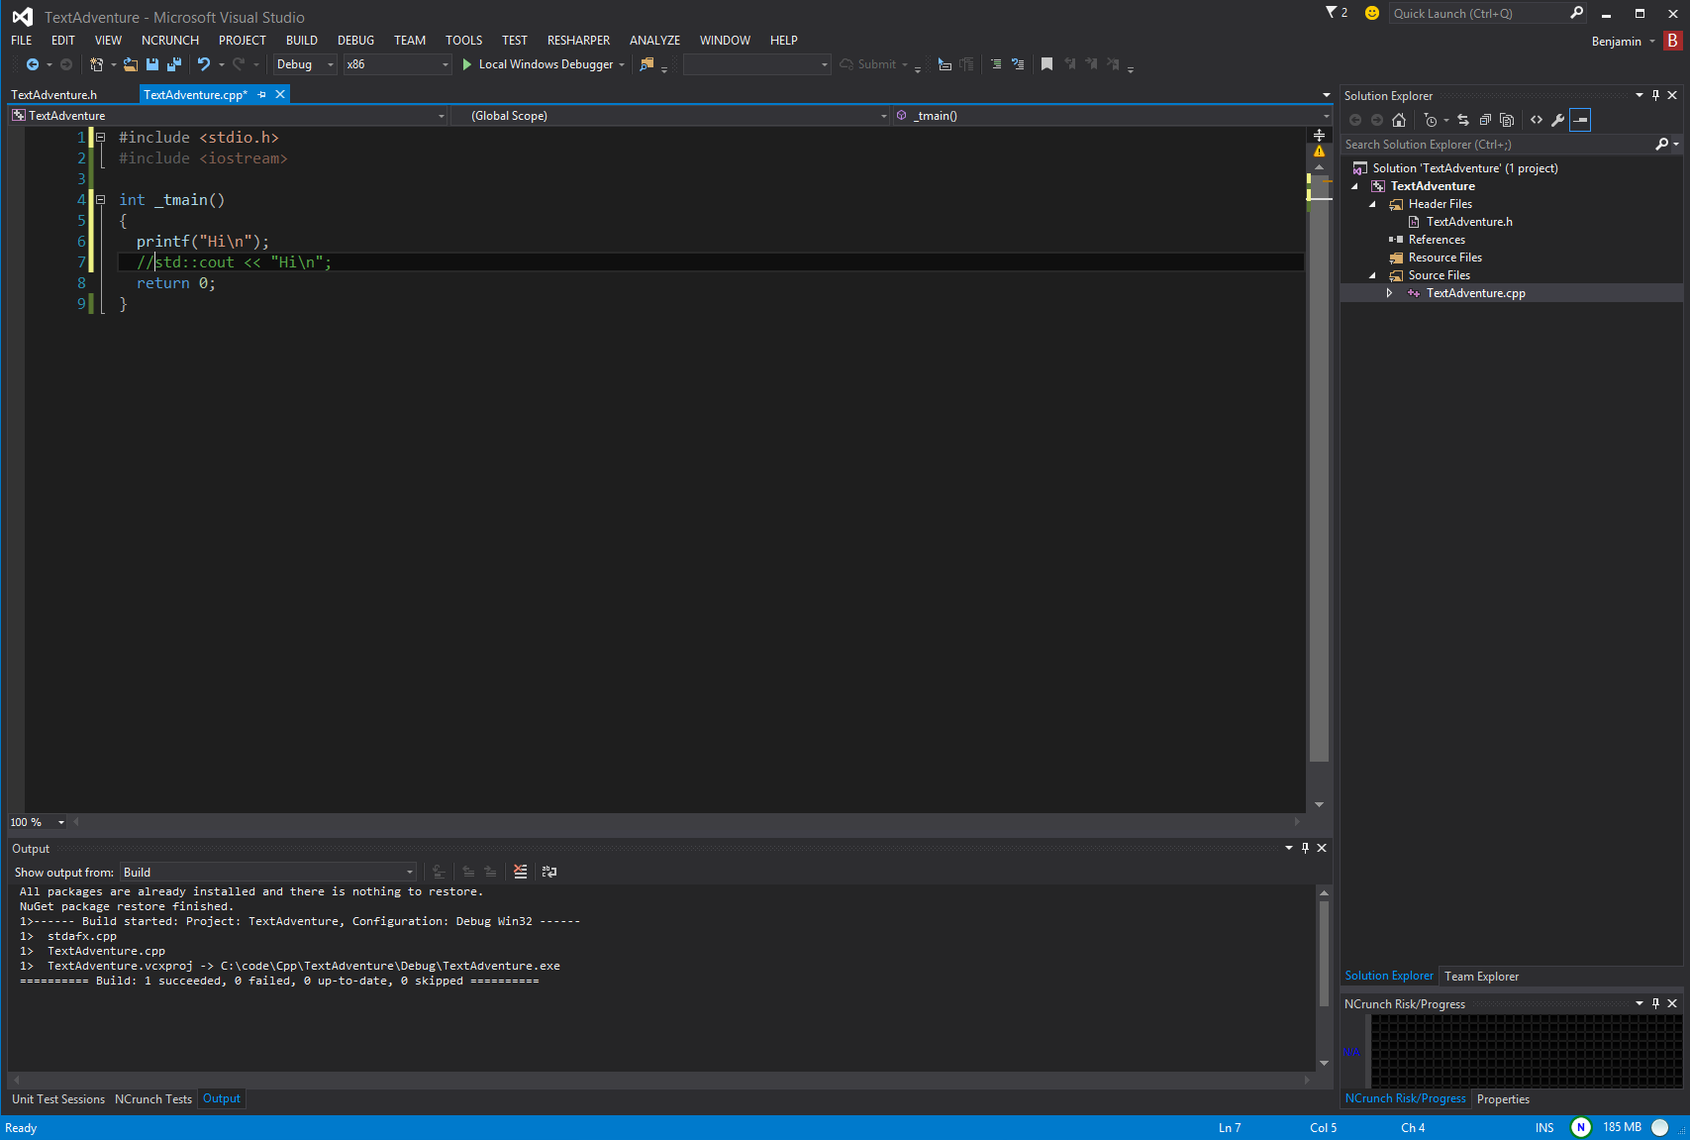
Visual Studio
Notes:
This is the IDE used for this course (I prefer the latest VS2015RC, which has the latest and greatest of C++11 and C++14 plus nice intellisense and refactoring, but it does not matter for this course, I normally utilize ReSharper too, which is beyond the scope here).
Make sure everyone is setup. It is by far the most common IDE on Windows, especially for C#, C++, VB and F# development. Since most games have been created on Windows, it is the most used IDE for game development, including big engines like Unreal, less so by Unity3D, but still possible.
Pretty much all development of DirectX games, Windows games, Xbox games is done via Visual Studio and you can certainly use it to create PlayStation, Android and other platform games too, only for iOS you pretty much are stuck with XCode on a Mac!

Slide 11
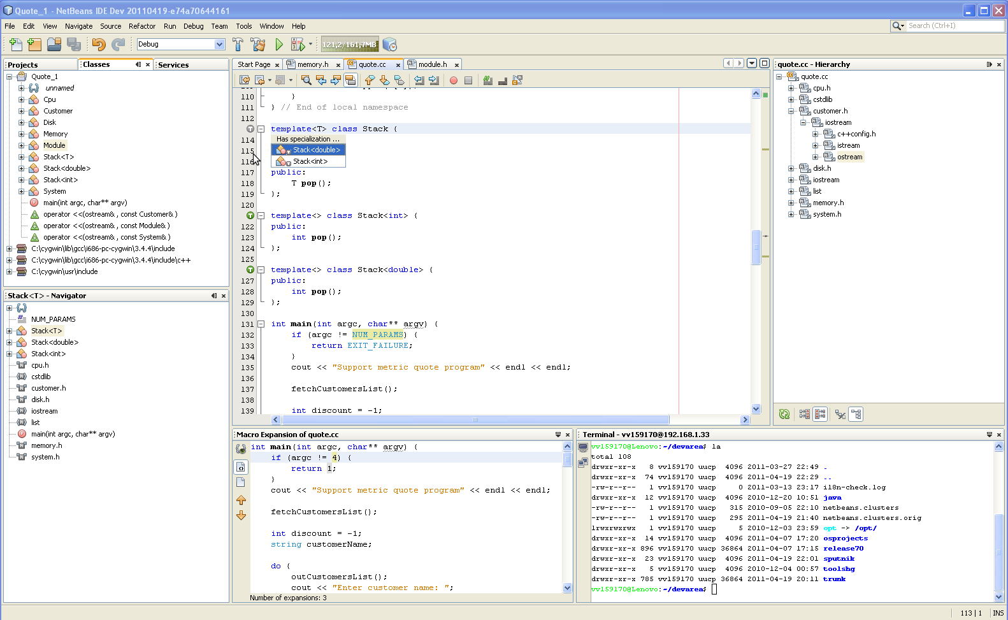
NetBeans

Slide 12
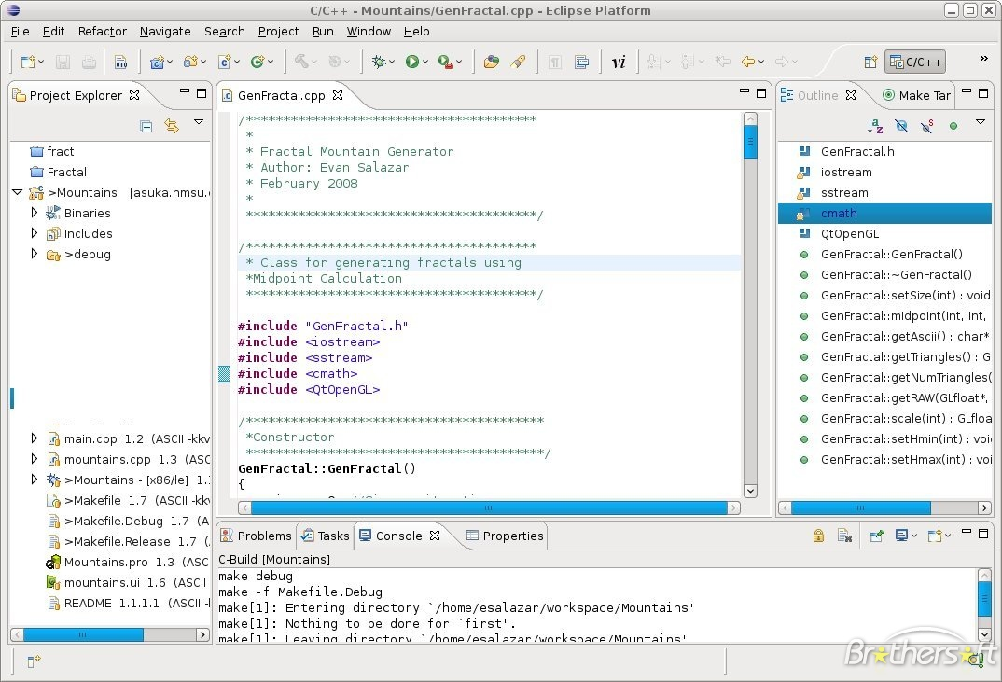
Eclipse

Slide 13
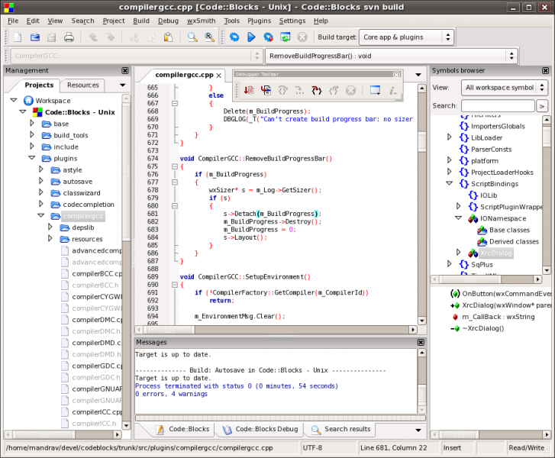
Code::Blocks

Slide 14
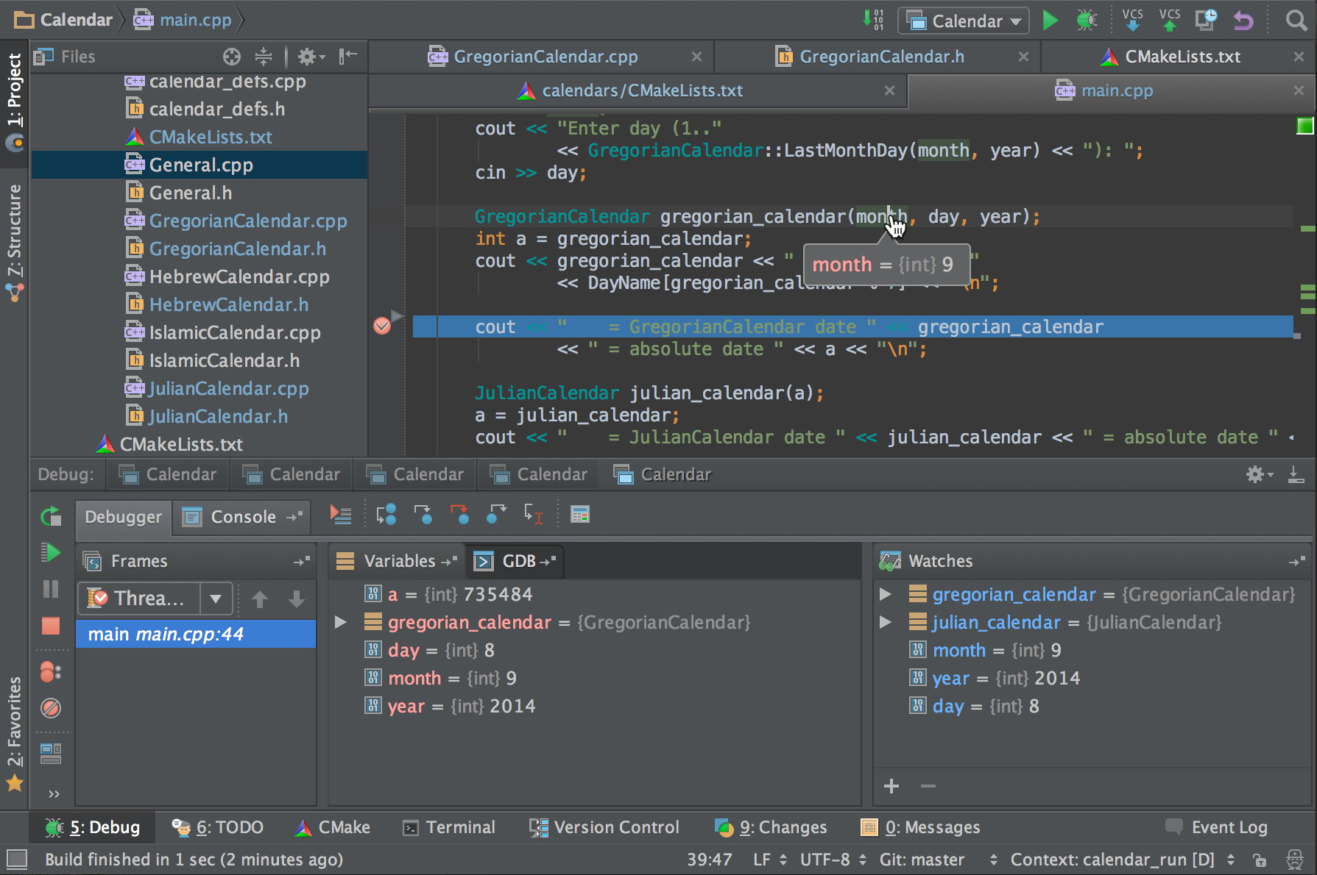
CLion

Slide 15
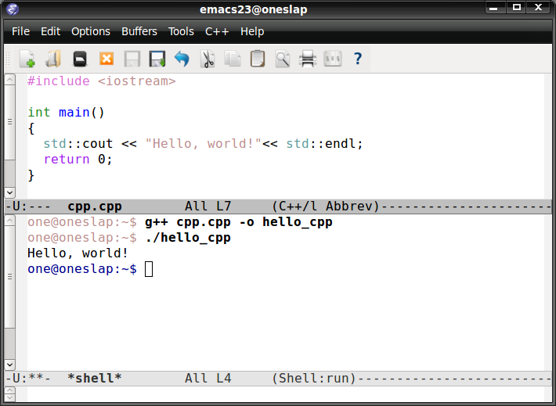
Emacs

Slide 16
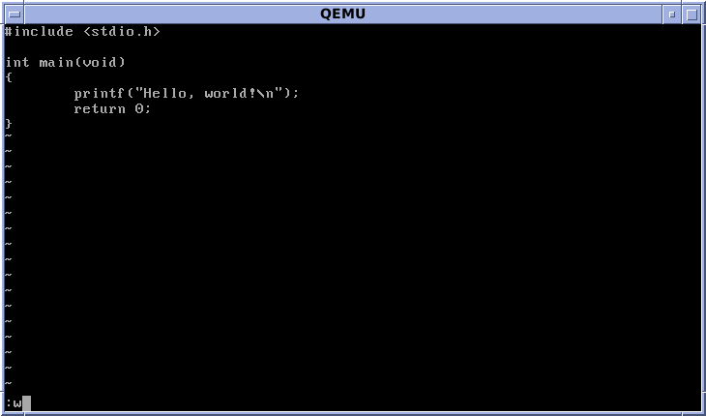
VI

Slide 17
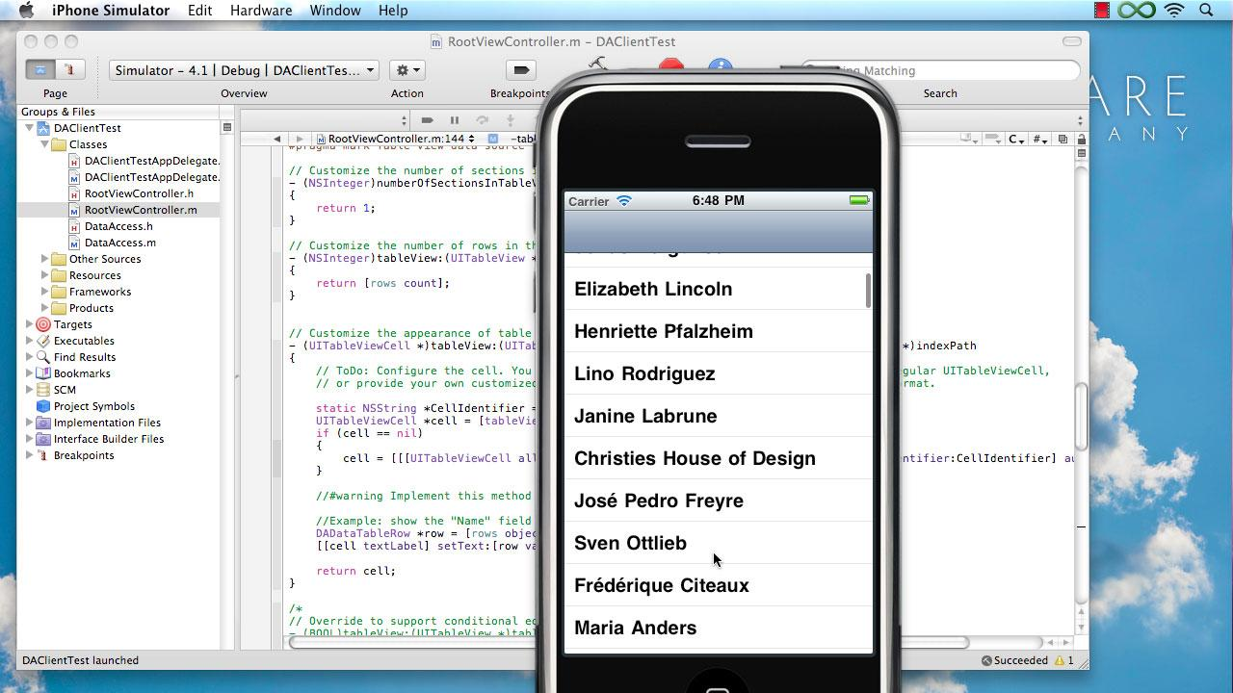
XCode (MacOS)
Notes:
Mostly used for Objective-C and Swift, but you can also do normal C++ programming with it. Pretty much the standard IDE for Mac and iOS Development, only exists there.

Slide 18
Visual Studio C++ Setup
Create a new C++ project “TextAdventure”
Let’s start with an empty console app (from VS)
Add a simple “Program.cpp” with:
#include <stdio.h>
#include <tchar.h>
int _tmain()
{
printf("Welcome to our Adventure\n");
return 0;
}
Notes:
Back to our PCs, make sure Visual Studio is installed and working, let’s get started.
stdio.h defines printf, which shows text in the console window
tchar.h is required for _tmain(), which is the unicode default entry point we want to use
printf is a simple c method call and uses one argument (the welcome string) that ends with \n to indicate a newline at the end of the text output
return 0 simply returns our program to the OS and ends the execution for now
Lets change it to cout >> string >> endl; by using iostream.h instead of stdio.h!

Slide 19
C++ Structure
uses
Header
uses
Header
Source File
Source File
Header
Header
Header
Header
compiles to
compiles to
...
Object File
Library
Library
Library
links
Executable or Library

Slide 20
C++ Features
Object Oriented
Data Hiding and Abstraction
Encapsulation
Inheritance
Polymorphism
Generics
Overloading & Operators
Pointers to everything (except value data)
Notes:
We assume all of this is known, short explanation is given if people are unsure

Slide 21
Coding Style
Test Driven Development (personal choice)
Pair Programming & Code Reviews
Correct is better than fast
Simple is better than complex
Prefer clarity over cuteness
Write code for people first, then machines
Premature optimization is the root of all evil
Can take a lifetime to learn => Clean Coder

Slide 22
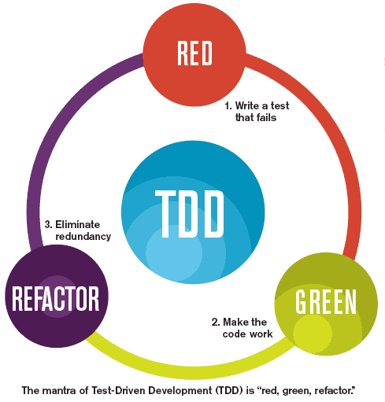
Test Driven Development

Slide 23
TDD Setup
We will use the built-in VS CppUnitTest
https://msdn.microsoft.com/en-us/library/hh419385.aspx
Create a new native unit test project
Adds “$(VCInstallDir)UnitTest\include” to Include Dirs
and “$(VCInstallDir)UnitTest\lib” to Library Directories
Name it “TextAdventureTests”
Add a reference to our TextAdventure main project
Rename unittest1.cpp to ProgramTests.cpp
Notes:
There are plenty C++ Unit Testing Frameworks as an alternative, I have used CppUnit and Google Test (my favorite) heavily in the past, but also BoostTest, xUnit++, CPUnit, Catch, etc.
Google Test is very easy to get started and one of the newer ones, also good choice to get started, especially when coming from a c# or java background. However it is a bit more tricky to setup in VS, so we go the easy route here with the built-in C++ Unit Testing from VS that works just fine with the Test Explorer in Visual Studio!

Slide 24
TDD first step: Start with a test
#include "stdafx.h"
#include "CppUnitTest.h"
#include "Program.h"
using namespace TextAdventure;
using namespace Microsoft::VisualStudio::CppUnitTestFramework;
namespace TextAdventureTests
{
TEST_CLASS(ProgramTests)
{
public:
TEST_METHOD(AddStringNumbers)
{
//Assert::AreEqual(Program::AddStringNumbers("2 + 1"), 3);
}
};
}
Notes:
The Assert is commented out for now, we just want to get things compiling, which is always the first step with C++
In order to find Program.h we need to add “../TextAdventure” to the include directories (TextAdventureTests should sit in a neigbor directory)
Normally only dll projects with proper __declspec(dllimport) and __declspec(dllexport) can be tested and unlike C# we cannot simply reference .exe files and test them via reflection.
Here we just use a simple trick, see next slide.

Slide 25
TDD Step 1 should fail, only then fix it
Does it compile, everything syntax correct?
Linker error? Investigate (this is not easy)
No code written yet, write the minimum to satisfy the test (in our case just return 3).
Everything setup and working, but Assert fails? Time to improve the production code!
When everything works, refactor and clean
Start over with the next failing test
Notes:
The whole cycle should not take longer than a few minutes, this way you always have working code from a few minutes ago you can go back to if anything goes bad.
Learning is process will slow you down, especially when learning a new language, but after a while you will pick up speed and produce code that is more useful, reusable and more enjoyable to work with.

Slide 26
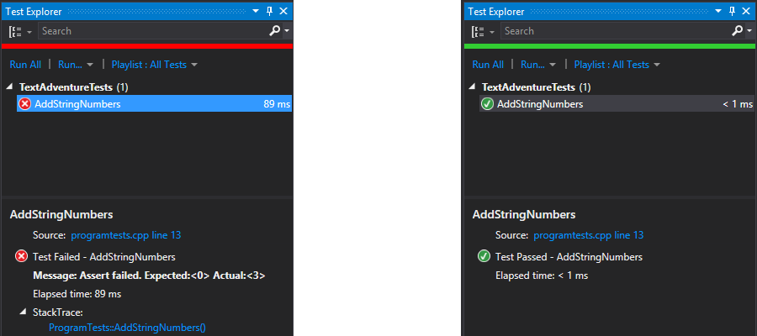
TDD Step 2: Make the code work
int TextAdventure::Program::AddStringNumbers(const char * text)
{
return 3;
}
Notes:
The default hotkey to run all tests of the Test Explorer is Ctrl+R+A, I usually assign it to F6 as well.
With Visual Studio Ultimate Edition it is possible to run all tests after each build, sadly this feature is missing from the free VS Community Edition (which is VS Professional). I wrote a addin a few years ago to help with this (have not updated this for a while): https://github.com/DeltaEngine/TestAfterBuild

Slide 27
TDD Green: Isn’t that cheating?
No, based on the specification our code works
We need more tests to specify the problem better and make our program more general!
And now we have a failing test once again.
TEST_METHOD(AddStringNumbers)
{
Assert::AreEqual(Program::AddStringNumbers(""), 0);
Assert::AreEqual(Program::AddStringNumbers("2 + 1"), 3);
Assert::AreEqual(Program::AddStringNumbers("3 + 4"), 7);
Assert::AreEqual(Program::AddStringNumbers("335835 + 5834"), 335835 + 5834);
}
Notes:
Assert::AreEqual accepts two variables of the same type, the first is named expected, but in many xUnit frameworks, especially with fluent syntax like Assert.That(number, Is.EqualTo(5)) the expected value comes last, which is easier to read and understand!

Slide 28
Actual Functionality at last
int TextAdventure::Program::AddStringNumbers(
const char* inputText)
{
std::string text = std::string(inputText);
if (text.empty())
return 0;
auto plusIndex = text.find('+');
return std::stoi(text.substr(0, plusIndex)) +
std::stoi(text.substr(plusIndex + 1));
}
Notes:
Explain how we solve this problem and what happens if we have a mistake in there (e.g. not adding the +1 for the substr of the right part).
We will talk more about std::string soon, if you have any questions at this point, I will give a quick overview.

Slide 29
Basic C++ Statements we need
Classes, functions, code blocks
Primitive types: int, uint, bool, char, float
Operators (same in most languages): +, -, *, /, ?, ++, --
Pointers: arrays, strings, void*, shared_ptr
Control flow: if, else, switch
Loops: for, do, while
Lists: vectors, iterating with for
Casting, null, const, allocation, free
Console IO: cin, >>, cout, <<, endl
Enumerations, Unions, Classes & Namespaces
Notes:
We just used test classes and had functions, this is done. We also have used for, if and variable creation plus assignment, plus pointer arithmetic.
Here we give a quick overview of the most important concepts, if details are needed we can go to https://docs.google.com/viewer?a=v&pid=sites&srcid=ZGVmYXVsdGRvbWFpbnxjczEwMWF0anVzdHxneDo1ZmI0M2NmNjMxMDEwYjQ3
Skipped here: macros, generics and other advanced topics

Slide 30
Classes and Data Hiding
Encapsulation is an Object Oriented Programming concept that binds together the data and functions that manipulate the data, and that keeps both safe from outside interference and misuse. Data encapsulation led to the important OOP concept of data hiding.
A class can contain private, protected and public members. By default, all items defined in a class are private.
Use public methods to access private data
Only use protected if you need something in a derived class
Notes:
http://www.tutorialspoint.com/cplusplus/cpp_data_encapsulation.htm
http://herbsutter.com/gotw/_100/

Slide 31
Classes and Data Hiding
// Example class from a simple sample game
class BouncingLogo : public Sprite {
public:
BouncingLogo(std::shared_ptr<Texture> texture, std::shared_ptr<Randomizer> random);
protected:
void Render(Renderer* renderer, std::shared_ptr<Time> time);
private:
std::shared_ptr<Time> time;
Point velocity;
float rotationSpeed;
};
Notes:
From the public C++ Delta Engine source code (December 2012)

Slide 32
Functions
Definition: returnType MethodName(parameters) { statements }
int AddNumbers(int first, int second) { return first+second; }
call: int result = AddNumbers(3, 4);
void SaySomething() { cout << “Something”; }
call: SaySomething();
Vector operator +(const Vector& other) const;
Vector result = Vector(1, 2, 3) + Vector(3, 4, 5);
& passes the other Vector as a reference instead of as a value type
const for the parameter means it will not change in the method
const for the method means it will not change the value of the object called upon (in this case the first vector uses its + operator)
Vector(float x = 0.0f, float y = 0.0f, float z = 0.0f);
Notes:
http://www.cplusplus.com/doc/tutorial/functions/
Constructors have no return type, = is used for default parameters (value can be omitted, but only from end, we cannot simply omit x)

Slide 33
Recursion
TEST_METHOD(FibonacciNumbers)
{
Assert::AreEqual(Program::Fibonacci(1), 1);
Assert::AreEqual(Program::Fibonacci(3), 2);
Assert::AreEqual(Program::Fibonacci(4), 3);
Assert::AreEqual(Program::Fibonacci(5), 5);
Assert::AreEqual(Program::Fibonacci(6), 8);
Assert::AreEqual(Program::Fibonacci(7), 3);
}
static int Fibonacci(int iterations)
{
if (iterations <= 2)
return 1;
else
return Fibonacci(iterations - 2) + Fibonacci(iterations - 1);
}
Notes:
Recursion is of course possible too, but if possible try to do a more efficient for or while loop if you can do it with the operation you want to perform.
A typical example for recursion is the fibonacci numbers: 1, 1, 2, 3, 5, 8, etc.

Slide 34
Primitive Types and Operators
Any type can be prefixed with “signed” (default) or “unsigned” (by itself this is an unsigned int). Each C++ Implementation on each platform can have different sizes for primitive types, minimums:
8 bit
char
16 bit
short
int (usually 32 bit)
bool (uses int)
32 bit
long
float
64 bit
long long
double
// Creation and assignment
int number = 27;
Assert::AreEqual(number, 27);
// Dividing int numbers always returns the rounded down value
number /= 2;
Assert::AreEqual(number, 13);
// int with 32-bit cannot handle any number above 2147483647
number = 2147483649;
Assert::AreEqual(number, -2147483647); // Overflows to the negative
// Use long long instead, which can handle around 20 digits
long long bigNumber = 2147483648;
Assert::AreEqual((double)bigNumber, 2147483648.0);
Notes:
Bool is implemented as int, but is usually just 0=false or 1=true, any value except 0 is considered true in c++, bool was only added in C++99
2147483648 overflows to -2147483648, but we cannot check for that as Assert only accepts ints starting at -2147483647.
Also Assert::AreEqual is not implemented for long long, comparing it causes a compiler error, use the double version (64bit) instead. See what happens if .0 is removed, is this different in C#/Java/etc?

Slide 35
Custom types with better certainty
For example Unreal Engine (but pretty much any big library or framework) defines these types:
uint8, int8,
uint16, int16,
uint32, int32,
uint64, int64
bool (is uint32)
FString and FText
and many more
// Definitions on a 64-bit platform
typedef unsigned char uint8;
typedef unsigned short uint16;
typedef unsigned int uint32;
typedef unsigned long long uint64;
// Use sizeof to figure out what the size is
Assert::AreEqual(sizeof(int), size_t(4));
Notes:
You can still write code with the built-in types, but if a library demands a certain coding style and uses its own types, you better follow the guidelines to avoid chaos.
sizeof returns a std::size_t value, which is defined in cstdlib since C++11, it can be used pretty much as an int.

Slide 36
Using variables
This is the same in any imperative programming language:
// Creating any variable gives us direct access
int number = 8;
number++;
Assert::AreEqual(number, 9);
// Assigning the variable to something else creates a copy!
int otherNumber = number;
number++;
Assert::AreEqual(otherNumber, 9);
Assert::AreEqual(number, 10);
Notes:
In computer science terminologies, imperative programming is a programming paradigm that describes computation in terms of statements that change a program state. http://en.wikipedia.org/wiki/Imperative_programming
Functional programming languages are different (declarative programming as opposed to imperative, which changes state), direct assignment or even changing values is not allowed usually. Instead copies are created and the old value is discarded.

Slide 37
Pointers
C is all about pointers, with C++11 or using std:: or boost it can be hidden away, but C++ is still about pointer references
Pointer Operators:
Address Of
&
Dereference
*
Define
*
Arithmetic
+, -, =,
==, >, <, ...
// Point to the number from our previous example
int *pointToNumber = &number;
Assert::AreEqual(*pointToNumber, 10);
// We can reassign the pointer to any other int value
pointToNumber = &otherNumber;
Assert::AreEqual(*pointToNumber, 9);
(*pointToNumber)--;
Assert::AreEqual(*pointToNumber, 8);
Notes:
The same can be done without the extra pointer variable by just using &number and dereferencing it again *(&number) gives us the value of number.
Warning: Working with pointers IS dangerous, see what happens when removing the parenthesis from (*pointToNumber)--; It breaks the whole test as we are now pointing to some random number in memory one below otherNumber!
If you are coming from Java or C# you have used pointers all along, any non value type (no primitives and no structs) is referenced by a pointer, you can even use primitive as pointers in method parameters via ref or out.

Slide 38
Creating data via pointers
Normally you want to create new data (objects, arrays, etc.) dynamically in your program, which reserves some memory:
Creation
new
Deletion
delete
Array creation
new T[size]
Mark unused
null
Manual creation
malloc
// Anytime you create something with new memory is
// allocated and if available the constructor is invoked
int *pointToNumber = new int;
// Unlike C# or Java data is NOT zero initially, it will be
// whatever was at that memory location before.
Assert::AreNotEqual(*pointToNumber, 0);
*pointToNumber = 17;
Assert::AreEqual(*pointToNumber, 17);
Program *program = new Program();
// You are responsible for cleanup if you created something (continued)
Notes:
Things can be complicated when dereferencing a pointer, you end up with a pointer to a pointer. To get to the value you have to use two dereferencing operators like **pointerToPointer

Slide 39
Creating data via pointers continued
After delete you should not longer use the deleted pointers!
// You are responsible for cleanup if you created something!
delete pointToNumber;
delete program;
// The pointer still points to the data, but the value is not longer ours Assert::AreNotEqual(*pointToNumber, 17); //might still point to 17 in release mode!
Assert::IsNotNull(program);
// It is better to null out pointers after deletion so we do not use them anymore
pointToNumber = NULL;
program = NULL;
// Anything executed here on pointToNumber or program causes an Access Violation,
// which cannot be catched in C++ (it is a hardware exception) unlike C# or Java.
Notes:
Things can be complicated when dereferencing a pointer, you end up with a pointer to a pointer. To get to the value you have to use two dereferencing operators like **pointerToPointer

Slide 40
Using smart pointers is simpler
pointer vs std::unique_ptr vs std::shared_ptr vs std::weak_ptr
TEST_METHOD(UsingSmartPointers)
{
std::shared_ptr<int> pointToNumber = std::make_shared<int>();
*(pointToNumber.get()) = 4;
Assert::AreEqual(*(pointToNumber.get()), 4);
} // pointToNumber pointer is automatically destroyed here, there is no GC in C++
TEST_METHOD(CreateABunchOfPrograms)
{
// This is basically how you would use a generic list like in C# (using templates in C++)
std::vector<std::shared_ptr<Program>> programs;
programs.push_back(std::make_shared<Program>(std::string("Program 1")));
programs.push_back(std::make_shared<Program>(std::string("Program 2")));
Assert::AreEqual(programs.size(), size_t(2));
Assert::AreEqual(programs[0]->Name, std::string("Program 1"));
} // The programs vector and all of the created Programs are automatically destroyed here
Notes:
For the std pointers we need to include the <memory> header file! For the vector we need the <vector> header file. And finally for strings we need <string>, which should be added to Program, where we need to add a constructor and the Name as well:
class Program
{
public:
Program(std::string name)
: Name(name) {}
std::string Name;
static int AddStringNumbers(const char* inputText);
};
Also explain a bit more about how .get() gives us the pointer and why we have to dereference it both when changing the value and when accessing it.
Also why do we need std::string for the Assert and why can we obmit it from the make_shared constructor creation? It is because for constructors the implicit operator from char* to std::string can be used, but for Assert::AreEqual the compiler has no idea which type we want to target. Just one of the many shortcomings in C++ and why we have to write a bit more code to make things compile.

Slide 41
We will touch more details later on
Enumerations & Switch statement
Unions can be used to share memory on different data types
enum Color { RED, GREEN, BLUE }; Color color = RED; // Notice Color:: is not needed in C++ std::string result;
switch(color)
{ case RED:
result = "red";
break;
case GREEN:
result = "green";
break;
case BLUE:
result = "blue";
break;
}
Assert::AreEqual(result, std::string("red"));
struct SharedData
{
enum { CHAR, INT } type;
union
{
char letter;
int number;
};
};
SharedData data1 = { SharedData::CHAR, 'a' };
Assert::AreEqual(data1.letter, 'a');
Assert::AreEqual(data1.number, 97);
SharedData data2 = { SharedData::INT, 121 };
Assert::AreEqual(data2.letter, 'y');
Assert::AreEqual(data2.number, 121);
Notes:
Enumerations work like in C# or Java, but enumeration values are just like constants and have no functionality or reflection features like in Java or C#.
Unions are not available in C# or Java, which allows for more flexible data layout in C++ and fun and dirty pointer tricks.
Use google, stackoverflow, http://en.cppreference.com/w/ or http://www.cplusplus.com/ if you are unsure or need quick help on how to define things, which header to use.

Slide 42
Back to our adventure
Game Design (open discussion)
Which characters are available?
What world setting are we in?
How long should the gameplay be?
Are there puzzles, collectables, health?
What kind of weapons, spells or skills?
Any more ideas?
Notes:
Everyone can create their own theme, but we discuss the one I present

Slide 43
Live Coding
Creation of the Text Adventure Game
TDD implementation of choices
Basically a simple state machine
Class for the player values (quests, maybe health, weapons, skills, etc.)
If we have time, things can get more complex
Notes:
Since we will be coding together now slides do not make so much sense, most things need to be explained and everyone should be typing his game. Links to the existing TextAdventure code will be given in the next slide, which we will only look at by the end of today.

Slide 44
Questions?
All code and these slides are available at:
https://github.com/BenjaminNitschke/CppCourse/Day1

Slide 45
Books
The C++ Programming Language (Bjarne Stroustrup)
Thinking in C++ (Bruce Eckel)
Effective Modern C++(C++14, Scott Meyers)
API Design for C++ (Martin Reddy)
The C++ Standard Library (Nicolai Josuttis)
Game Programming Gems 1-8
Clean Code (Robert C. Martin)

Slide 46
C++ & Game Development Links
MIT Introduction to C++ Course
http://www.stroustrup.com/Programming
http://www.cplusplus.com/
http://nehe.gamedev.net/
https://www.unrealengine.com/
http://www.gamedev.net/
http://stackoverflow.com/
https://github.com/lefticus/cppbestpractices

